Slide 1
Chapter 6
Daoism & Confucianism

Slide 2
Learning Objectives (1 of 2)
6.1 Describe the ancient Chinese tradition of ancestor worship and the concept of cosmic balance.
6.2 Identify the basic principles for life in harmony with Dao.
6.3 Outline the practices associated with popular religion and organized Daoism.
6.4 Explain the increasing interest in Daoist practices and philosophy in the West.

Slide 3
Introduction The general goals of Chapter 6 are:
(1) to present the foundations and defining characteristics of Daoism and Confucianism; (2) to highlight the differences between these two religions but also explain their complementary relationship; and
(3) to describe the many forms of Chinese religious expression.

Slide 4
Introduction
Daoism and Confucianism are two religious traditions of ancient China.
As religious and social forces, they have coexisted for centuries in China and have spread to other Asian regions such as Korea and Japan.
While their respective approaches to religious questions such as the meaning of existence and the most productive way to approach life’s problems are different, they coexist and offer complementary values of such a nature that one person’s actions and thoughts can encompass both sets of traditions.

Slide 5
East Asia Religious Traditions
Not absolutist – Believing in one’s received traditions as completely and exclusively true
Not exclusivist – Belief that one’s own tradition is the only true religion and that others are invalid
Treated as separate entities but are not
Daoism & Confucianism – may seem opposite to each other, co-exist as complementary value systems in East Asian societies
China – Temples may include images from the Three Teachings
Buddhism
Daoism
Confucianism
Notes:
religions that will be treated as separate entities in this chapter and the following one are, in fact, more subtly blended and practiced. Daoism and Confucianism, though they may seem quite opposite to each other, co-exist as complementary value systems in East Asian societies, and a person’s thought and actions may encompass both streams. The idea of distinct religions is not prominent in Chinese thought. Even though scholars may trace the historical threads of Daoism, Confucianism, and Buddhism, Chinese people tend to refer to their religious practices simply as “worshiping,” and temples may include images from more than one of the “Three Teachings.”
three other major religions were developing in East Asia. Daoism and Confucianism grew largely in China, and later spread to Japan and Korea; Shinto is considered distinctively Japanese. In this chapter we will explore the two that developed in China from similar roots but with different emphases: Daoism and Confucianism. Buddhism also spread to East Asia, where its encounter with Chinese traditions developed its world-affirming qualities. Buddhism is now the most common religion in China. There are also popular religious practices and beliefs that persist alongside, and mixed with, the more formalized religious ways, even as China becomes highly modernized and economically progressive.

Slide 6
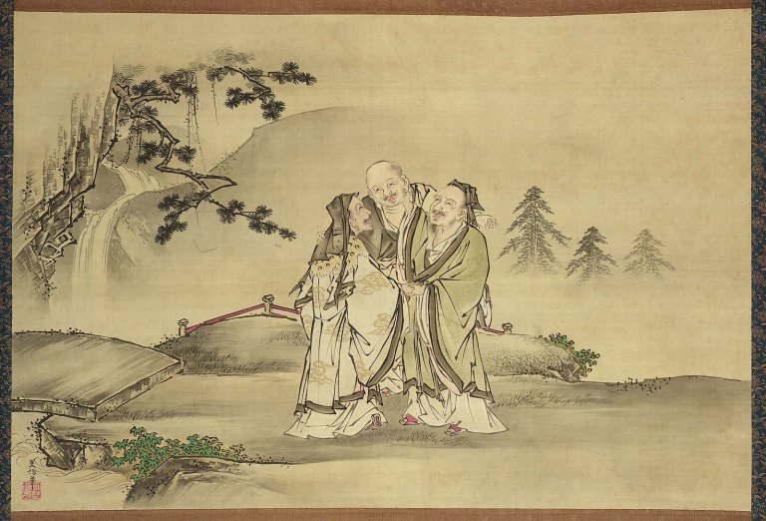
East Asia Religious Traditions
Confucius, Lao Tzu and Buddha meeting, symbolizing the harmony between the three philosophers and their teachings
Notes:
Confucius, Lao Tzu and Buddha meeting, symbolizing the harmony between the three philosophers and their teachings

Slide 7
Introduction
The encounter of Buddhism with the Chinese traditions opened this faith tradition to develop global qualities.
Buddhism is the most common religion in China.
Buddhism may complement aspects of Daoist and Confucian belief and practice.

Slide 8
Introduction
The idea of distinct religions is not prominent in Chinese social thought.
Chinese people tend not to strictly distinguish Buddhism, Daoism, and Confucianism, referring to all their religious practices as “worshiping” and attending temples with images from all “Three Teachings.”

Slide 9
Learning Objectives (2 of 2)
6.5 Outline the major teachings of Confucius.
6.6 Define Neo-Confucianism.
6.7 Discuss the ways in which Confucianism is being adapted to modern concerns in mainland China and other parts of East Asia.

Slide 10
6.1 Ancient traditions
The spiritual ways of ancient Chinese civilization, dating back to 2000 BCE, have influenced all later developments
Notes:
Simon Man-ho Wong, interviewed September 21, 2013.

Slide 11
6.1 Ancient traditions Worship and divination
Ancestor veneration in the form of rituals called li involves funerals, mourning rites, and continuing sacrifices.
Ancestors not cared for were thought to cause trouble for their descendants, and kings sought the guidance of their ancestors through divination using oracle bones.
The world was thought to be full of invisible spirits—be they ancestors, the spirits of charismatic humans, or nature spirits.
Notes:
Simon Man-ho Wong, interviewed September 21, 2013.

Slide 12
6.1 Ancient traditions Worship and divination
Various rites were used to ward off the actions of demons and ghosts.
During the reign of the Shang kings, the ancient belief was in Shangdi (Shang Ti), the highest god or Lord-on-High, who was understood to be a masculine deity that ruled the universe.
In later eras, there was greater focus on the idea of Heaven as an impersonal power. Rulers justified their rule by citing the Mandate of Heaven.
Notes:
Simon Man-ho Wong, interviewed September 21, 2013.

Slide 13
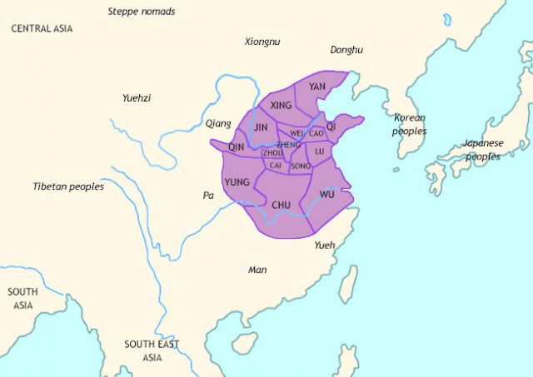
Zhou Dynasty c. 1046 BC – 256 BC

Slide 14
Worship and Divination (2 of 2)
“Mandate of Heaven” justified Zhou rule
The belief that Heaven responds to human virtue and, specifically, that it endows rulers with the authority to rule based on their virtue
It can also remove the mandate when a ruler’s virtue declines.
Rulers have a moral duty to maintain the welfare of the people and a spiritual duty to conduct respectful ceremonies for Heaven, Earth, and ancestors.
Notes:
reign of the Shang kings, there was a highest god, above deified humans, deities of the local environment, royal ancestors, and gods and goddesses of the cosmic forces. This highest god was Shangdi (Shang Ti) the Lordon-High. He was understood as a masculine deity who ruled over important phenomena such as the weather, crops, battles, and the king’s health. It was the king who was chiefly responsible for maintaining harmony between the transcendent realm of gods and ancestors and the earthly world. During the Zhou (Chou) dynasty (c. 1046–221 bce), which overthrew the Shang, the rulers continued to play major spiritual roles. However, the focus shifted from Shangdi to Tian, a more impersonal power controlling the universe. Though typically translated as “Heaven,” the character tian has also been translated as “Supreme Ultimate” and “One above man.” It may also be used to refer to the high god of the Chou dynasty, derived from the word for “sky.” Its precise meaning is not agreed upon, but it became an important point of reference for rulers as well as philosophers.

Slide 15
6.1 Ancient traditions Cosmic balance
Also important is the belief that the universe is a manifestation of qi (c’hi), an impersonal self-generating energy with two forces: yin (dark, receptive, female) and yang (bright, assertive, male).
The two forces operate in a regular pattern, a creative rhythm called the Dao (Tao) or way.
Notes:
Simon Man-ho Wong, interviewed September 21, 2013.

Slide 16

Cosmic Balance
qi: impersonal self-generating physical-spiritual substance.
yin: the dark, receptive, “female” aspect of qi
yang: the bright, assertive, “male” aspect of qi
Dao: “way,” the creative rhythm of the universe
Notes:
here has long existed in China a belief that the cosmos is a manifestation of an impersonal self-generating physical–spiritual substance called qi (ch’i). It is basically the “stuff” of which all things that exist are composed. It has two aspects, whose interplay causes the ever-changing phenomena of the universe. Yin is the dark, receptive, “female” aspect; yang is the bright, assertive, “male” aspect. Men and women have both aspects within themselves. Wisdom lies in recognizing their ever-shifting, but regular and balanced, patterns and moving with them. This creative rhythm of the universe is called the Dao (Tao), or “way.” As traditionally diagramed, yin and yang interpenetrate each other (represented by small circles). As soon as one aspect reaches its fullest point, it begins to diminish, while at the same time its polar opposite increases.

Slide 17
6.1 Ancient traditions Cosmic balance
Daoism is a scholarly (or literati) label applied to a wide array of beliefs and practices that range from a philosophical tradition to longevity practices. Religious Daoism may involve not only Daoist practices but Confucian virtues and Buddhist-style rituals.
For example, the worship of kitchen gods has mixed with Daoist elements, although Daoism as an institution has worked to distance itself from popular religion. Institutional Daoism seeks to be seen as a higher form of religion.
Daoism ultimately is a tradition of great mental and physical discipline.
Notes:
Simon Man-ho Wong, interviewed September 21, 2013.

Slide 18
6.2 Daoism—The way of nature and immortality
Various forms of divination have long been used to achieve harmony with the cosmic process.
One important divination technique uses divining objects such as coins cast six times, which creates a combination explained in the Yijing (I Ching) or Book of Changes.
Harmony with the cosmos is a central ideal in these ancient ways, and this ideal is expressed in differing ways in Daoism and Confucianism.
Notes:
Simon Man-ho Wong, interviewed September 21, 2013.

Slide 19
6.2 Daoism—The way of nature and immortality Teachings of Daoist sages
The historical origin of Daoist philosophy is unclear, but it is said to have started with the Yellow Emperor who is said to have ruled from 2697 to 2597 BCE.
He is understood to have studied with an ancient sage who taught him about meditation, health, and military practices.
Notes:
Simon Man-ho Wong, interviewed September 21, 2013.

Slide 20
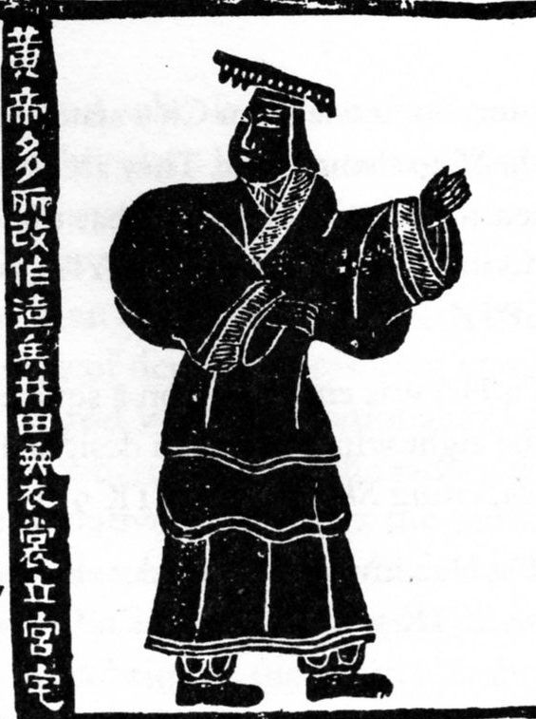
Teachings of Daoist Sages (1 of 2)
Tradition attributes the earliest teachings to the Yellow Emperor (r. 2687–2597 BCE).
'The Yellow Emperor created and changed a great many things; he invented weapons; he divide fields; he devised upper and lower garments, and established palaces and houses'
Notes:
the specific origin of Daoist philosophy and practices is unclear. In China, tradition attributes the publicizing of these ways to the Yellow Emperor, who supposedly ruled from 2697 to 2597 bce. He was said to have studied with an ancient sage and to have developed meditation, health, and military practices based on what he learned. After ruling for 100 years, he ascended to heaven on a dragon’s back and became one of the Immortals.
mural painting from Han dynasty

Slide 21
6.2 Daoism—The way of nature and immortality Teachings of Daoist sages
There are two major texts of the Daoist literati or philosophical tradition.
The first is the Dao de jing (Tao te Ching, “The Classic of the Way and Its Power”).
Chinese tradition states that the Dao de jing was written by Laozi in the sixth century BCE, but archeological evidence suggests the text may be somewhat later.
Notes:
Simon Man-ho Wong, interviewed September 21, 2013.

Slide 22
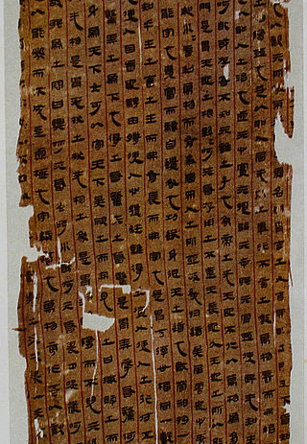
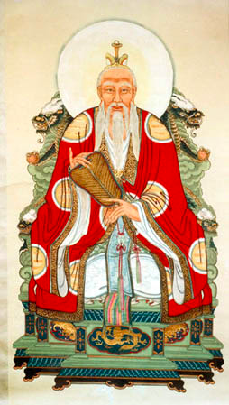
Daoism
Manuscript of Laozi’s Classic of the Way and the Virtue, 2nd century BCE
Undated painting of Laozi
Notes:
Left image retrieved from https://commons.wikimedia.org/wiki/File:Mawangdui_LaoTsu_Ms2.JPG
Right image retrieved from https://commons.wikimedia.org/wiki/File:DaodeTianzun.jpg

Slide 23
6.2 Daoism—The way of nature and immortality Teachings of Daoist sages
The central theme of the Dao de jing is that one can live most happily by harmonizing one’s self with the universe and with the challenges of life in general by being receptive to the beauty and direction of nature and by being quiet.
Notes:
Simon Man-ho Wong, interviewed September 21, 2013.

Slide 24
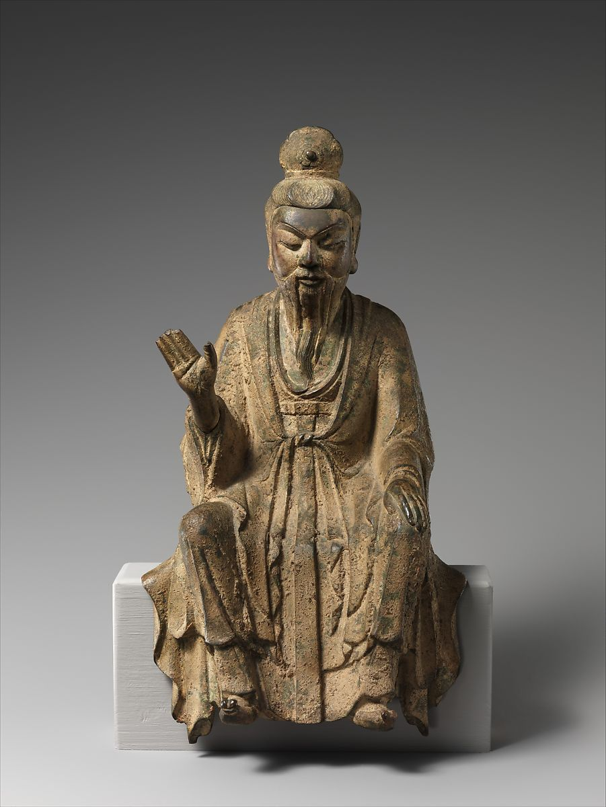
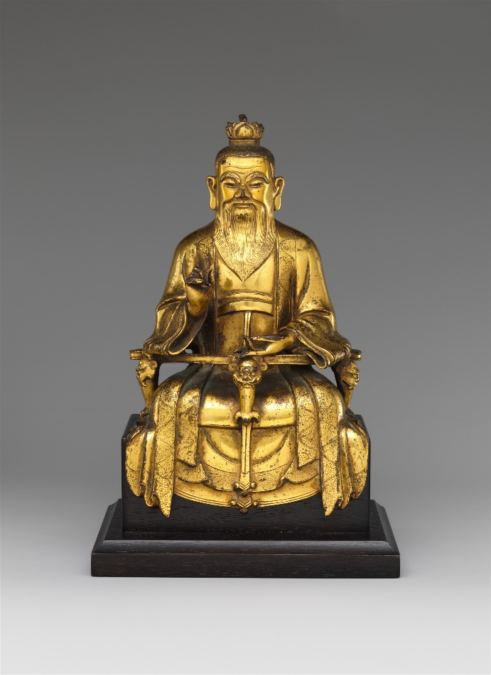
Laozi (Old Master)
Daoist Immortal, probably Laozi 10th century CE
Daoist immortal Laozi
dated 1438

Slide 25
Dao de jing - Mysticism
The way that can be spoken of
Is not the constant way;
The name that can be named
Is not the constant name.
The nameless was the beginning of heaven and earth;
The named was the mother of the myriad creatures.
Notes:
At the heart of Daoist teachings is the idea of Dao, the “unnamable,” the “eternally real.”4 Modern-day master Da Liu asserts that Dao is so ingrained in Chinese understanding that it is a basic concept that cannot be defined, like “goodness.” Moreover, Dao is a mystical reality that cannot be grasped by the mind.

Slide 26
Basic principles for the life in harmony with the Dao
The Daoist sage takes a low profile in the world.
He or she is like a valley, allowing everything needed to flow into his or her life, or like a stream.
Flowing water is a Daoist model for being. It bypasses and gently wears away obstacles rather than fruitlessly attacking them, effortlessly nourishes the “ten thousand things” of material life, works without struggling, leaves all accomplishments behind without possessing them.

Slide 27
6.2 Daoism—The way of nature and immortality Teachings of Daoist sages
The second major text is the Zhuangzi, attributed to the author of the same name (c. 365–290 BCE), who maintained that the best approach to life in a chaotic civilization is detachment.
Notes:
Simon Man-ho Wong, interviewed September 21, 2013.

Slide 28
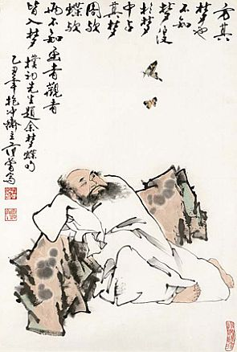
Zhuangzi (Chuang-tzu) (c. 365–290 BCE)
Elaborated on Daoist concepts
Asserted: best to detach from absurd civilization
Dao is “unnamable,” the “eternally real”
Notes:
Over the millennia the classic philosophical, or literati, form of Daoism has been pursued by intellectuals and artists, who explore the concepts about the Dao expressed in ancient texts and perhaps also try to apply them to their social and political environment in the effort to create a condition of harmony known as the Great Peace. The two most salient texts of the classic Daoist tradition are the Dao de jing and the Zhuangzi. The Dao de jing (Tao te Ching, “The Classic of the Way and its Power”) has been translated many times into Western languages, including more than 100 English translations, for its ideas are not only fascinating but also elusive for translators. According to tradition, the book was written for a border guard by Laozi (Lao-tzu), a curator of the royal library of the Zhou dynasty, when he left society for the mountains at the reported age of 160. The guard had recognized Laozi as a sage and begged him to leave behind a record of his wisdom. Laozi reportedly complied by inscribing the 5,000 words now known as the Dao de jing. This is traditionally said to have happened during the sixth century bce, with Laozi somewhat older than Confucius. But archaeological finds date the earliest existent version of the Dao de jing to 350 bce and suggest it was an alternative to Confucianism. Many scholars think it was an oral tradition, derived from the teachings of several sages, and question whether there was ever a single person corresponding to the name Laozi (Old Master).

Slide 29
Zhuangzi (Chuang-tzu) (c. 365–290 BCE)
These teachings were elaborated more emphatically and humorously by a sage named Zhuangzi
Unlike Laozi, whose philosophy was addressed to those in leadership positions, Zhuangzi asserted that the best way to live in a chaotic, absurd civilization is to become detached from it.
Notes:
Over the millennia the classic philosophical, or literati, form of Daoism has been pursued by intellectuals and artists, who explore the concepts about the Dao expressed in ancient texts and perhaps also try to apply them to their social and political environment in the effort to create a condition of harmony known as the Great Peace. The two most salient texts of the classic Daoist tradition are the Dao de jing and the Zhuangzi. The Dao de jing (Tao te Ching, “The Classic of the Way and its Power”) has been translated many times into Western languages, including more than 100 English translations, for its ideas are not only fascinating but also elusive for translators. According to tradition, the book was written for a border guard by Laozi (Lao-tzu), a curator of the royal library of the Zhou dynasty, when he left society for the mountains at the reported age of 160. The guard had recognized Laozi as a sage and begged him to leave behind a record of his wisdom. Laozi reportedly complied by inscribing the 5,000 words now known as the Dao de jing. This is traditionally said to have happened during the sixth century bce, with Laozi somewhat older than Confucius. But archaeological finds date the earliest existent version of the Dao de jing to 350 bce and suggest it was an alternative to Confucianism. Many scholars think it was an oral tradition, derived from the teachings of several sages, and question whether there was ever a single person corresponding to the name Laozi (Old Master).

Slide 30
6.3 Popular religion and organized Daoism
The second century CE saw the beginning of organized groups or sects of Daoism, using long-standing practices such as alchemy, faith healing, sorcery, and power objects.
Chinese popular religious practice has long included worship of spirits who may affect one’s destiny.
Notes:
Simon Man-ho Wong, interviewed September 21, 2013.

Slide 31
6.3 Popular religion and organized Daoism
The Kitchen God is one of the familiar spirits and may be propitiated with animal offerings.
Folk tradition asserts that the Kitchen God, or spirit, lives in a family’s kitchen and makes an annual report to Jade Emperor the about the family’s virtues and failings.
Notes:
Simon Man-ho Wong, interviewed September 21, 2013.

Slide 32
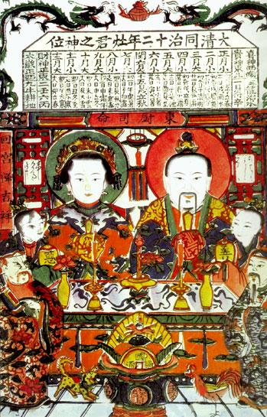
6.3 Popular religion and organized Daoism
To ensure a good report, during the Lantern Festival at the end of Chinese New Year celebrations, the Kitchen God may be offered something sweet or intoxicating.
Notes:
Simon Man-ho Wong, interviewed September 21, 2013.

Slide 33
6.3 Popular religion and organized Daoism
Villages may make collective offerings to spirits affecting their well-being.
The use of talismans is also widespread, as well as worship of virtuous people understood to have become divine after death.
Families may hire either Daoist or Buddhist priests to perform funeral rites.
Notes:
Simon Man-ho Wong, interviewed September 21, 2013.

Slide 34
6.3 Popular religion and organized Daoism
Some forms of Daoism advocate withdrawal from the hectic activity of everyday life for a life of contemplation and seeking harmony. One means of seeking harmony is feng shui, a form of geomancy that examines the flow of qi to determine the ideal placement of a building, grave, or even home furnishings.
Notes:
Simon Man-ho Wong, interviewed September 21, 2013.

Slide 35
6.3 Popular religion and organized Daoism Inner alchemy
One key component of Daoist practices is individual spiritual practices for self-cultivation, longevity, and perhaps immortality.
These practices, said to be passed down secretly from teacher to pupil, seek to use the energy available to the body for physical health and intuitive perception of the universal order.
Notes:
Simon Man-ho Wong, interviewed September 21, 2013.

Slide 36
6.3 Popular religion and organized Daoism Inner alchemy
The body contains the “three treasures” of generative force (jing), vital life force (qi), and spirit (shen).
Breathing techniques, diets, visualization, and so on, may be used to activate the three treasures.
Literature and folk tradition refer to sages thought to be centuries old; especially famous are the Eight Immortals.
The Daoist canon includes writings of some female sages who undertook transformative exercises.
Notes:
Simon Man-ho Wong, interviewed September 21, 2013.

Slide 37
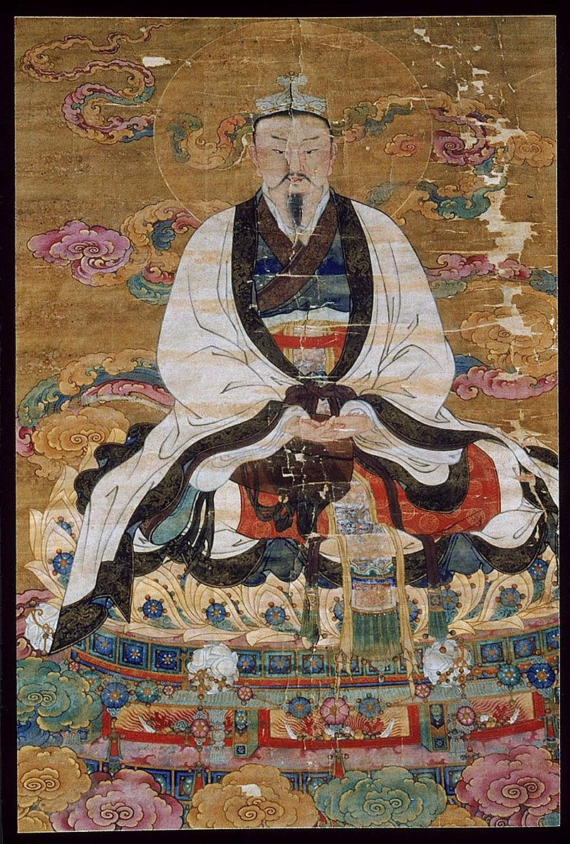
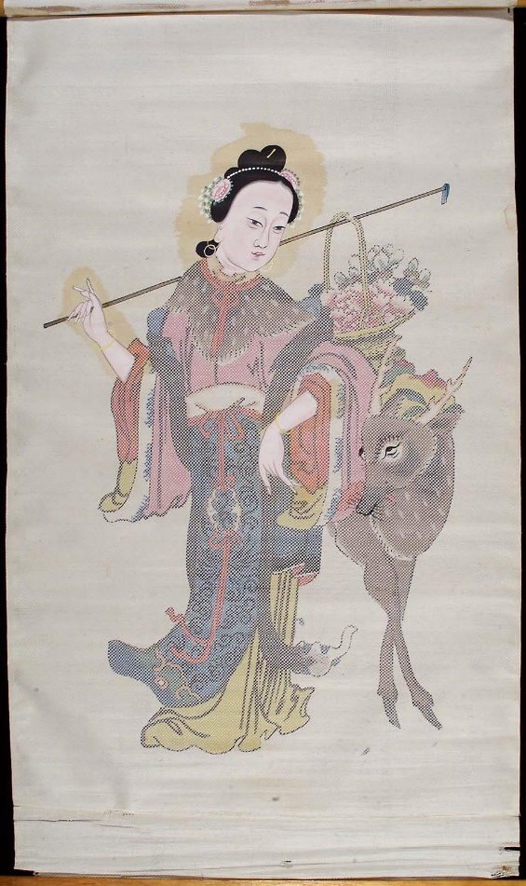
Deities and Daoist Masters (Immortals)
He Xiangu—the only female immortal, depicted carrying a lotus, the symbol of purity
Jade Emperor

Slide 38
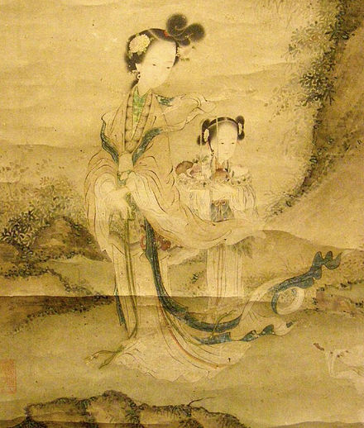
6.3 Popular religion and organized Daoism Inner alchemy
The Queen Mother of the West is an important celestial being who guards the elixir of life.
Notes:
Simon Man-ho Wong, interviewed September 21, 2013.

Slide 39
6.3 Daoist Sects
Institutionalization of such ancient, esoteric, and popular practices into distinctive religious movements, with revealed texts, detailed rituals, and priests serving as ritual specialists, developed in the Han Dynasty (206 BCE–220 BCE).
At the same time, in western China, Zhang Daoling (Chang Tao-ling) had a vision in which he was the appointed Dao on earth and was given the title Celestial Master.
Notes:
Simon Man-ho Wong, interviewed September 21, 2013.

Slide 40
6.3 Daoist Sects
The organized Daoist sects developed complex rituals and texts and had organized clergy.
Some sects were founded on the basis of visionary revelations.
Some, such as Highest Purity Daoism, advocated celibacy.
Notes:
Simon Man-ho Wong, interviewed September 21, 2013.

Slide 41
6.3 Daoist Sects
In the fourth century, the Numinous Treasure group arose, assimilating elements of Buddhism.
It, in turn, was succeeded by a school called Complete Perfection, the dominant Daoist monastic tradition since the twelfth century.
Complete Perfection incorporates Daoist inner alchemy, Chan Buddhist meditation, and Confucian social morality.
Notes:
Simon Man-ho Wong, interviewed September 21, 2013.

Slide 42
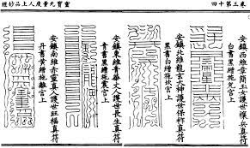
6.3 Daoist Sects
The present Daoist canon, compiled in 1445 CE, contains more than 1,500 scriptures but has not yet been thoroughly studied by non-Daoist scholars.
Notes:
Simon Man-ho Wong, interviewed September 21, 2013.

Slide 43
6.3 Daoist Sects
A Daoist or Buddhist priest may be hired by a deceased person’s family to perform rituals to help the deceased.
Each Temple has a side shrine dedicated to Tudi Gong (T’u-ti Kung), the local earth god who helps transport offerings to the deceased.
Notes:
Simon Man-ho Wong, interviewed September 21, 2013.

Slide 44
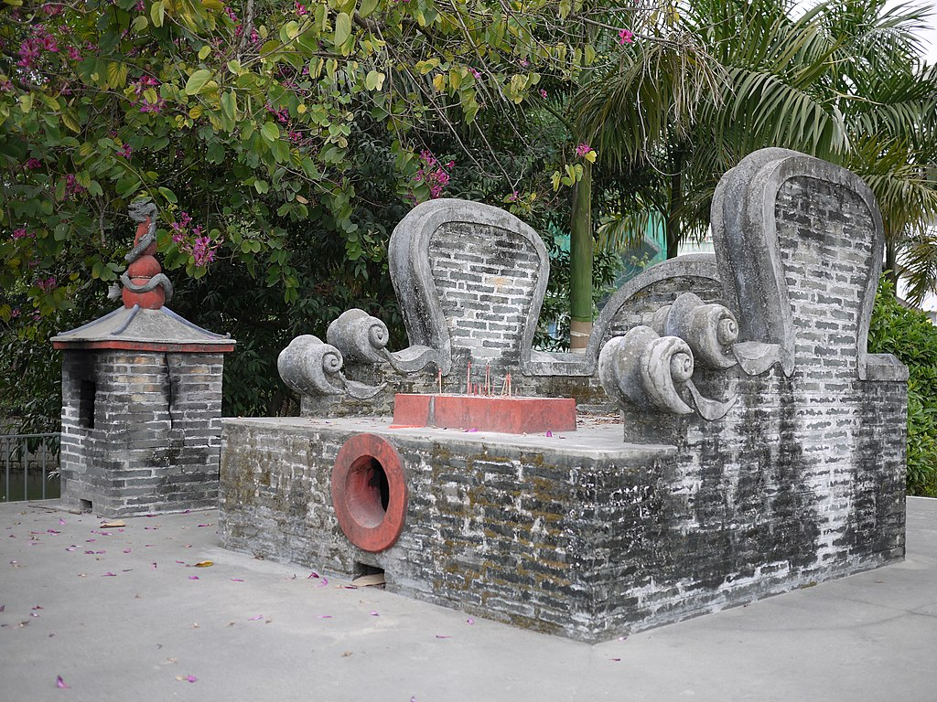
6.3 Daoist Sects
A Daoist or Buddhist priest may be hired by a deceased person’s family to perform rituals to help the deceased.
Each Temple has a side shrine dedicated to Tudi Gong (T’u-ti Kung), the local earth god who helps transport offerings to the deceased.
Notes:
Simon Man-ho Wong, interviewed September 21, 2013.

Slide 45
6.4 Daoism today
Daoist practices are still pursued in communist mainland China as well as Taiwan, Hong Kong, Korea, and overseas Chinese communities.
Chinese temples combine Confucian, Buddhist, and Daoist elements; however, liturgy is usually Daoist.
Throughout Chinese history, rulers have sometimes demanded allegiance to their own particular form of religion and suppressed others.
Under communism, religion has been persecuted as well.
Notes:
Simon Man-ho Wong, interviewed September 21, 2013.

Slide 46
6.4 Daoism today
Although the government of modern China (the Communist Party of the People’s Republic of China) remains officially antireligious, there has been a recent resurgence of religious practice throughout the country, and Confucian, Daoist, Buddhist, Muslim, and Christian religious sites are being built.
Notes:
Simon Man-ho Wong, interviewed September 21, 2013.

Slide 47
6.4 Daoism today
Hong Kong, now part of the People’s Republic of China, has long been home to many Daoist practices, and Daoist organizations there pursue social welfare and educational programs.
Academic study of Daoism is intensifying as well.
Notes:
Simon Man-ho Wong, interviewed September 21, 2013.

Slide 48
6.4 Daoism today
In both Asia and the West, Daoism continues in three major forms: organized religious institutions, societies for self-cultivation, and practitioners of techniques for spiritual development, health, and longevity.
Daoist ideas are also being promoted to help curb the environmental and social damage caused by rapid industrialization in China.
Notes:
Simon Man-ho Wong, interviewed September 21, 2013.

Slide 49
6.4 Daoism today
Spiritual development techniques such as acupuncture, traditional Chinese herbal medicine, and the energy training practice of Taiji quan (T’ai chi ch’uan, which is a series of dancelike postures that look like swimming in the air) are now popular (though not necessarily in a spiritual context, much like some western yoga practice).
Self-cultivation systems incorporating traditional health exercises are generally known as Qigong (ch’i-kung), used both in China and the West to cure disease and improve concentration and health.
Notes:
Simon Man-ho Wong, interviewed September 21, 2013.

Slide 50
6.5 Confucianism—the practice of virtue
Confucianism originated about the same time as Daoism did, during the sixth century BCE, an era of great spiritual teaching throughout India, Greece, and China.
This was approximately the era of the Buddha, maybe Laozi, Persia’s empire, Athens’s Golden Age, and the Hebrew prophets.

Slide 51
6.5 Confucianism—the practice of virtue
In Chinese, Confucius is known as Kong Fuzi (Master Kong) and his teachings are called Rujiao, “the teaching of the scholars.” Confucian tradition is based on ancient Chinese beliefs in Heaven, ancestor worship, and the efficacy of ritual.
Confucius developed from these a school of thought that emphasizes the cultivation of moral virtues and interaction between human rulers and Heaven, with political involvement as a way of transforming the world.

Slide 52
6.5 Master Kong’s life
Confucius was born during the Zhou dynasty into a genteel family that had fallen on hard times due to a change in the ruling dynasty.
His father died when he was three, and his mother died when he was twenty-three.
After her death, he entered a three-year mourning period during which he studied ancient ceremonial rites.

Slide 53
6.5 Master Kong’s life
He instructed students in the Six Classics of China’s cultural heritage, the Yijing, poetry, history, rituals, music, and dance. Today, only five of the six survive; the one on music has either been destroyed or perhaps never existed.
Confucius inspired his disciples to put together excerpts of what he taught them, which became the Analects of Confucius.
His teaching was considered fairly unimportant during his lifetime, and it was only in subsequent centuries that his contributions were widely recognized.

Slide 54
6.5 The Confucian virtues
Codified during the Han Dynasty, there are five cardinal virtues: humaneness, righteousness and justice, civility (ritual propriety), wisdom, and faithfulness.
Ren (jen) was among these virtues and, according to Confucius, the only way to save society.

Slide 55
6.5 The Confucian virtues
Ren can be translated as innate goodness, love, benevolence, humaneness, and human-heartedness and, according to Confucius, the only way to save society. .
It is the most important virtue extolled by Confucianism.

Slide 56
6.5 The Confucian virtues
A person devoted to ren is motivated by what is moral, not personal profit, seeks self-improvement rather than recognition, is mindful of parents, and believes human nature is essentially good.
Strong government was a key concern of Confucius; he believed that people must have faith in their rulers and that rulers in turn must lead virtuous lives to set a good example.

Slide 57
6.5 The Confucian virtues
Confucianism emphasizes relationships over individuality; as an example, the modern character for ren combines “two” and “person.”

Slide 58
6.5 The Confucian virtues
There are five basic relationships essential for a stable society: parent/ child, older/younger siblings, husband/wife, friend and friend, and ruler and subject.
These relationships involve mutual obligations and responsibilities, with the first party in each of these relationships considered superior to the second.

Slide 59
6.5 The Confucian virtues
Individuals are to cultivate morality within themselves and in turn within their families, society, and government.

Slide 60
6.5 The Confucian virtues
One’s relationship with parents is central; filial piety is a key moral principle.
There are three grades of filial piety: support one’s parents, avoid bringing humiliation to one’s parents and ancestors, and glorify them.
Filial piety extends to ancestor worship. The rites honoring ancestors and deities are called li, understood to be the earthly expressions of the natural cosmic order.
Confucius frequently eulogized about the Noble Person (junzi) of China’s high civilization.

Slide 61
6.6 Confucianism after Confucius
Later followers of Confucius added to his thought.
Mengzi (Latinized as Mencius) stressed the goodness of human nature, and the virtue of yi (righteous conduct).
Xunzi in contrast argued that humans are self-centered by nature and that Heaven operates according to natural laws rather than intervening on the side of good government.
The goal in Confucian learning is to become a sage, fully cultivate one’s own inner virtues, and act according to righteousness and in accord with the Way of Heaven.

Slide 62
6.6 The state cult
Confucianism was adopted by the state during the Han dynasty.
During the Han dynasty, the traditional Book of Rites and Etiquette and Ritual were reconstructed, with an increased emphasis on offerings to cultivate and preserve harmony between humanity, Heaven, and Earth.
Government officials were responsible for ritual sacrifices.

Slide 63
6.6 The state cult
At the family level, offerings were made to propitiate the family ancestors.
The most important ceremonies were performed by the emperor to give thanks and ask blessings from Heaven, earth, gods of the land and agriculture, and the dynastic ancestors.

Slide 64
6.6 Neo-Confucianism
Neo-Confucianism, which was popular during the period of disunity that followed the fall of the Han dynasty, stressed the importance of meditation and dedication to becoming a noble person; its tenets encouraged women to offer themselves in total sacrifice to others.

Slide 65
6.6 Neo-Confucianism
People seeking government positions had to pass examinations based on the five Confucian Classics.
In addition to the five Confucian Classics, the Four Books (Analects, Mencius, Great Learning, and Doctrine of the Mean) formed the core of Confucian education.
Neo-Confucianists stressed the importance of meditation and dedication to becoming a sage.

Slide 66
6.6 Neo-Confucianism
Neo-Confucianism spread to Korea and Japan.
In Korea, the religion became prominent, emphasizing education of scholar-officials and filial piety in the family.
In Japan, Neo-Confucian ideals influenced the development of scholar-samurai warriors and intense loyalty to the emperor.

Slide 67
6.7 Confucianism in the modern world
Confucian teaching on the importance of the scholarly life was strongly attacked by Mao Zedong. During the Cultural Revolution, Confucianism was attacked as one of the “Four Olds”—old ideas, culture, customs, and habits.
Confucian morality nonetheless forms the basis of Chinese ethics.

Slide 68
6.7 Confucianism in the modern world
After the ravages of the Cultural Revolution, there are a few hundred Confucian Temples that remained in China, with forty declared as National Cultural Heritage Sites.
People can visit and write requests on prayer cards.
Confucianism is helping to restore a sense of holy purpose into their lives.

Slide 69
6.7 Confucianism in the modern world
Recent Communist Party leaders have advocated Confucian virtues without naming them as such. Confucianism, however, is not officially recognized as a religion in China, while government approved forms of Buddhism, Islam, Daoism, Protestantism, and Christianity are.

Slide 70
6.7 Confucianism in the modern world
Some advocate “Capitalist Confucianism,” according to which business is conducted with the Confucian values of humanity, trustworthiness, sincerity, and altruism.
Partly for the sake of tourism, aspects of Confucianism are being revived, like the gala celebration of his birth.

Slide 71
6.7 Confucianism in East Asia
Singapore, Korea, Taiwan, and Japan have been strongly influenced by Confucian values.
According to Dr. Mary Evelyn Tucker, Confucianism is relevant now: “It aims to promote the flourishing social relations, effective educational systems, sustainable agricultural patterns, and human political governance within the context of the dynamic life-giving processes of the universe.”

